Slide 1

RUNGTA COLLEGE OF DENTAL SCIENCES AND RESEARCH
FACIAL PALSY
DEPARTMENT OF GENERAL MEDICINE

Slide 2
SPECIFIC LEARNING OBJECTIVES
NICE TO KNOW
DESIRE TO KNOW
MUST KNOW
ETIOLOGY
PATHOPHYSIOLOGY
ANATOMY
MEDICAL MANAGEMENT
SURGICAL MANAGEMENT
EVALUATION
ELECTROPHYSIOLOGY

Slide 3
CONTENTS
ETIOLOGY
EVALUATION
ANATOMY
CAUSES
PATHOPHYSIOLOGY
ELECTROPHYSIOLOGY
MEDICAL MANAGEMENT
SURGICAL MANAGEMENT
SUMMARY

Slide 4
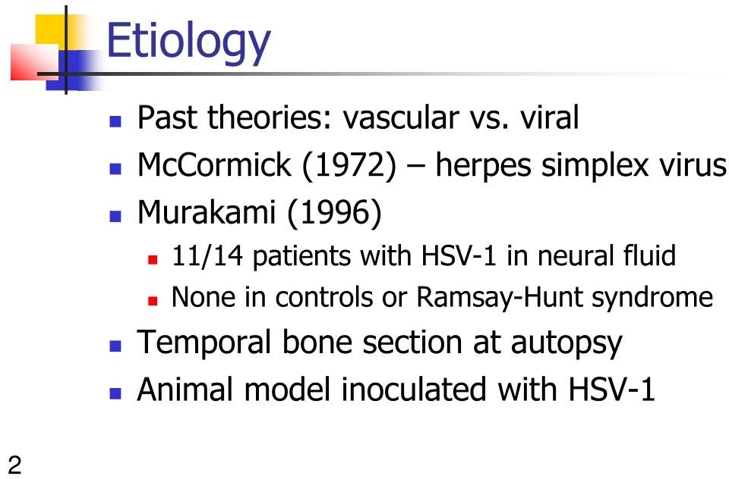

Slide 5
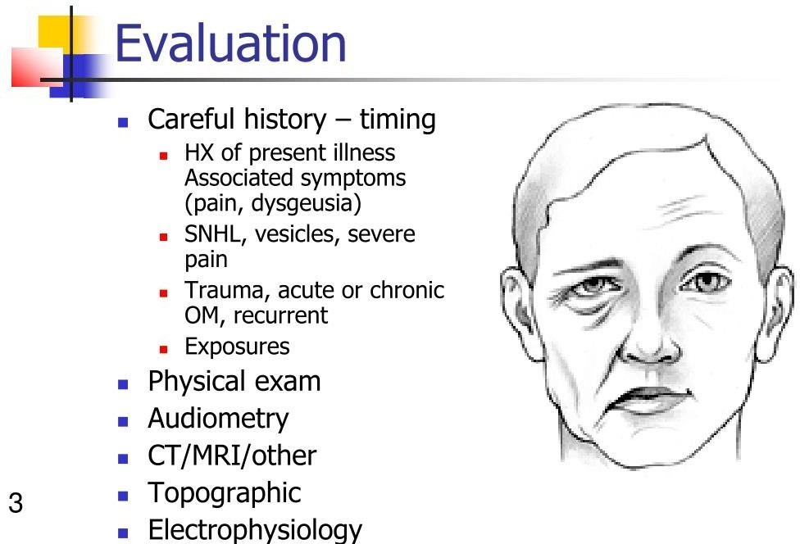

Slide 6
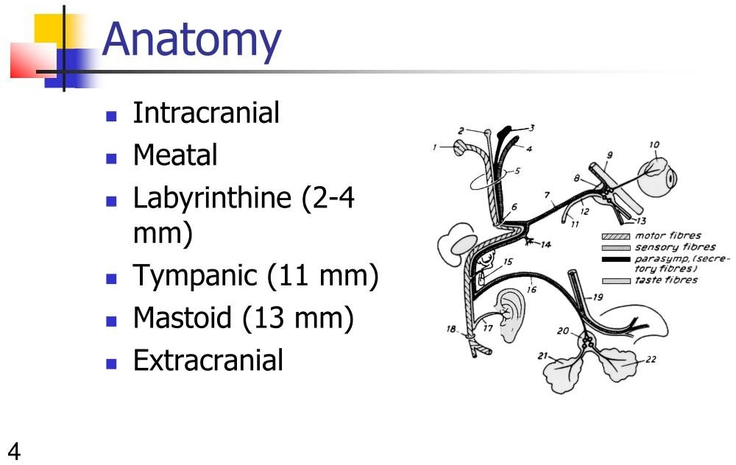

Slide 7
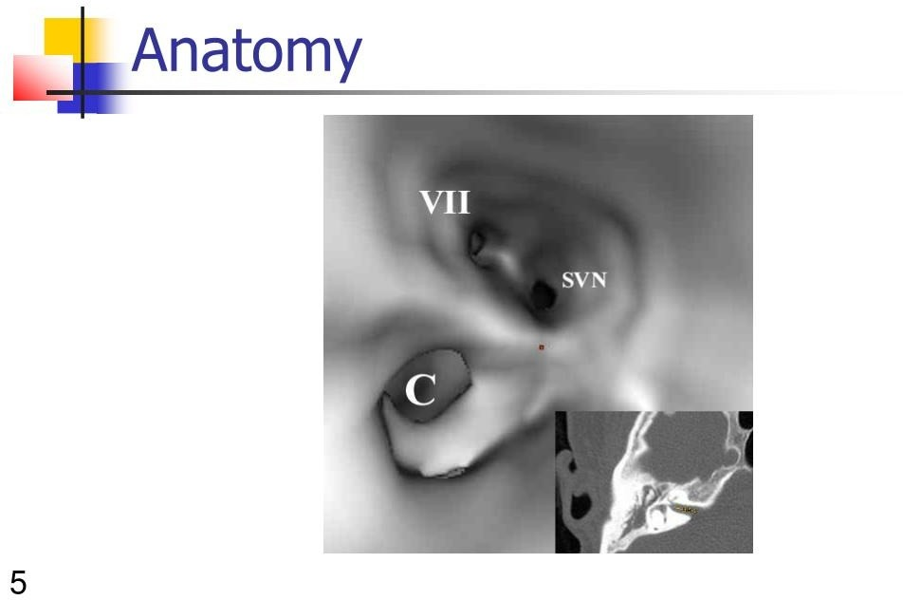

Slide 8
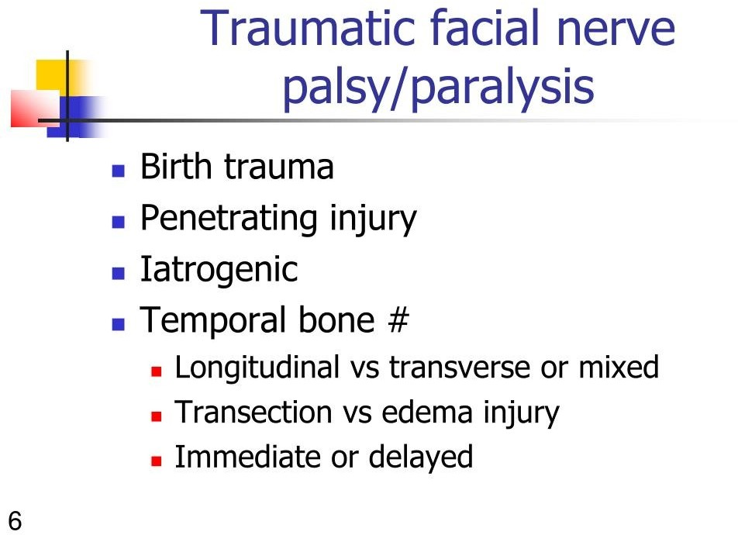

Slide 9
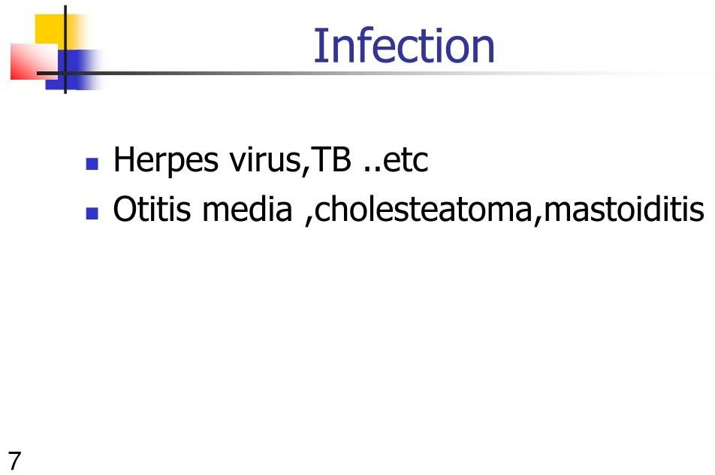

Slide 10
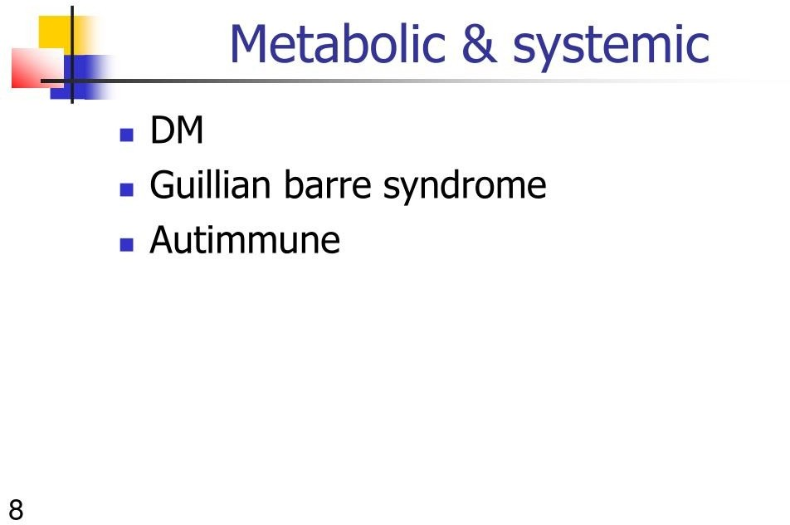

Slide 11
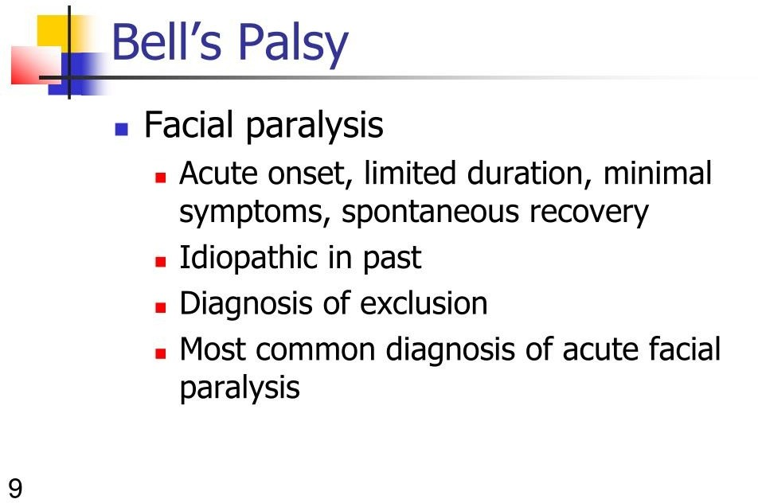

Slide 12
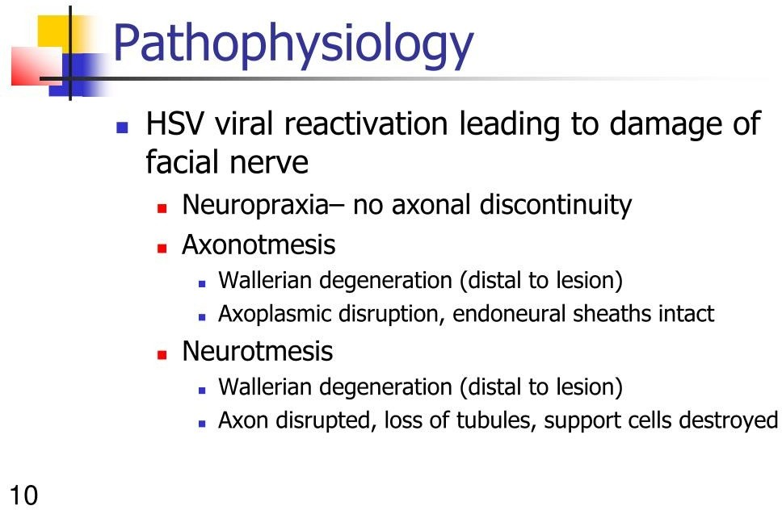

Slide 13
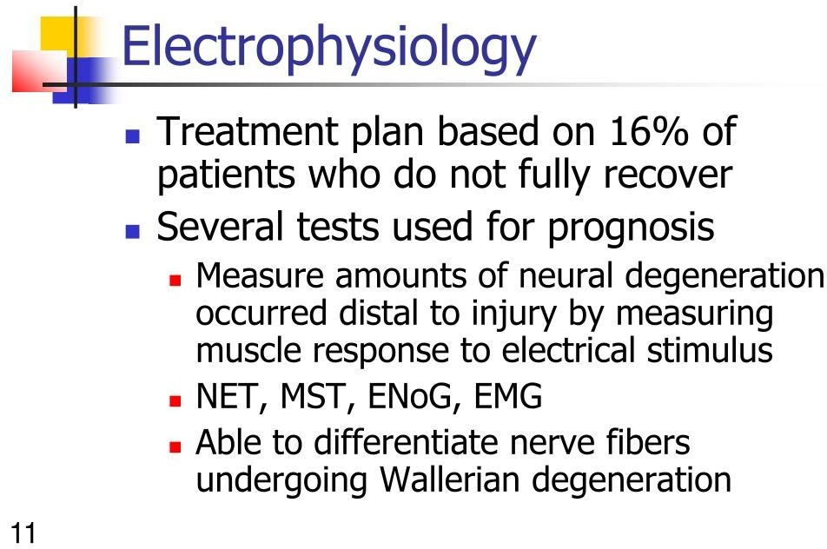

Slide 14
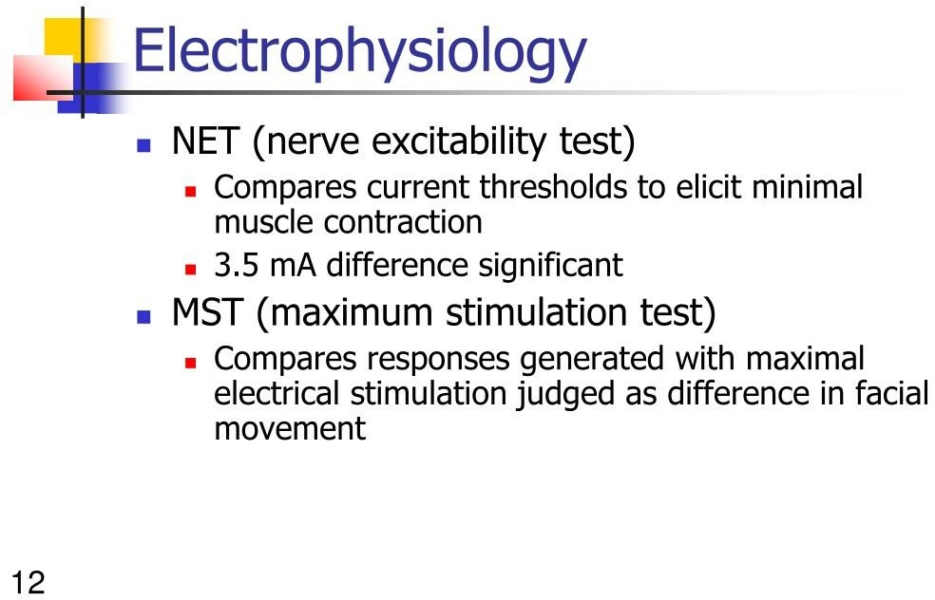

Slide 15
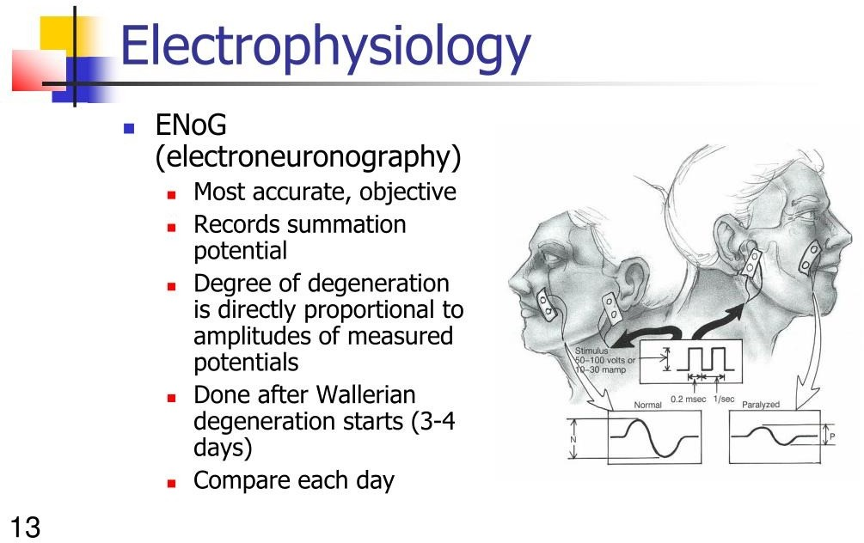

Slide 16
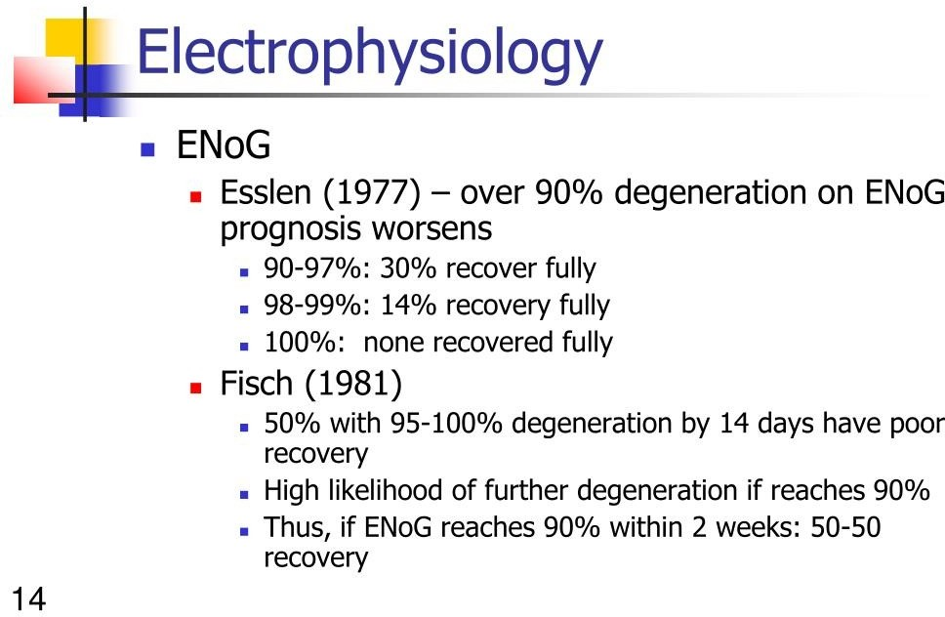

Slide 17
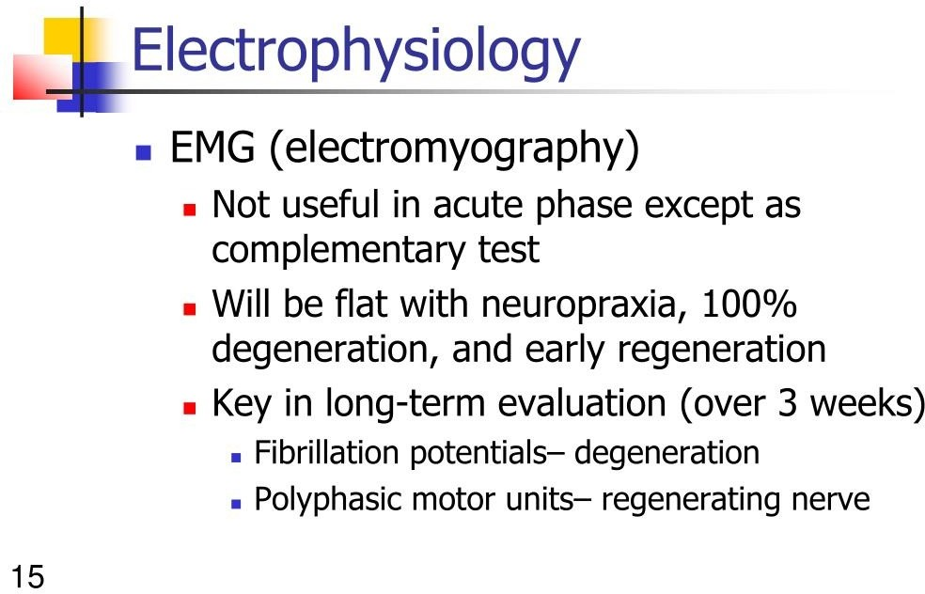

Slide 18
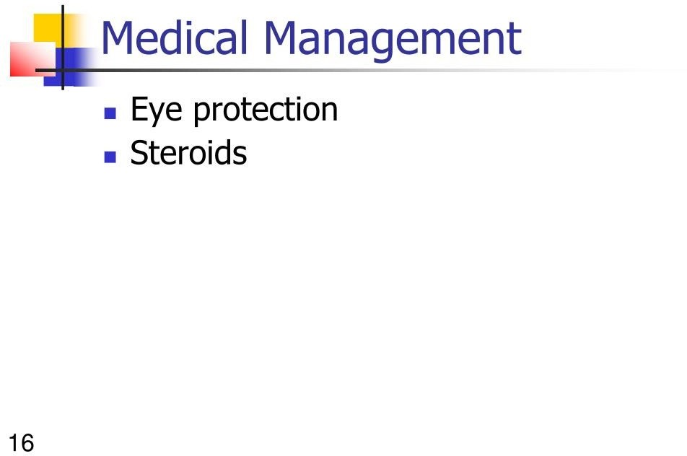

Slide 19
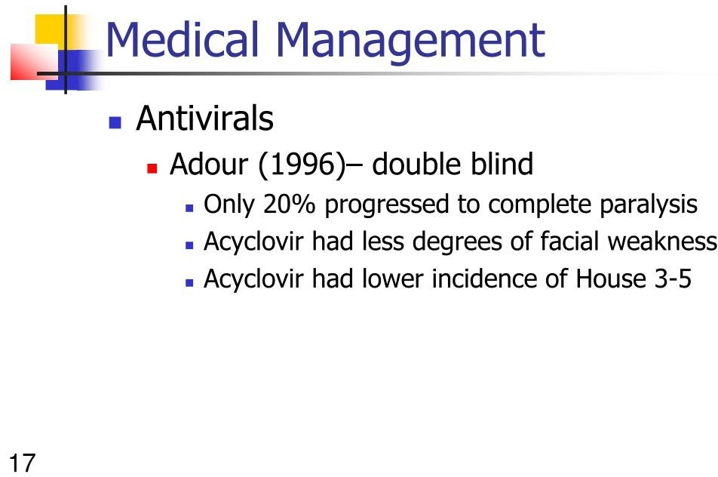

Slide 20
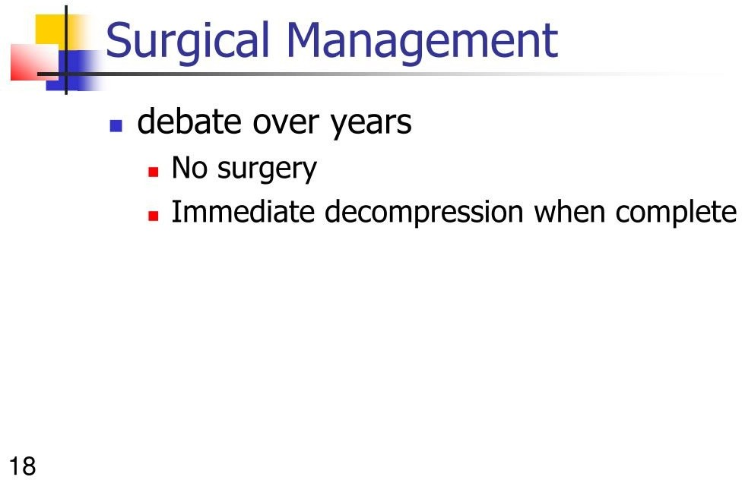

Slide 21
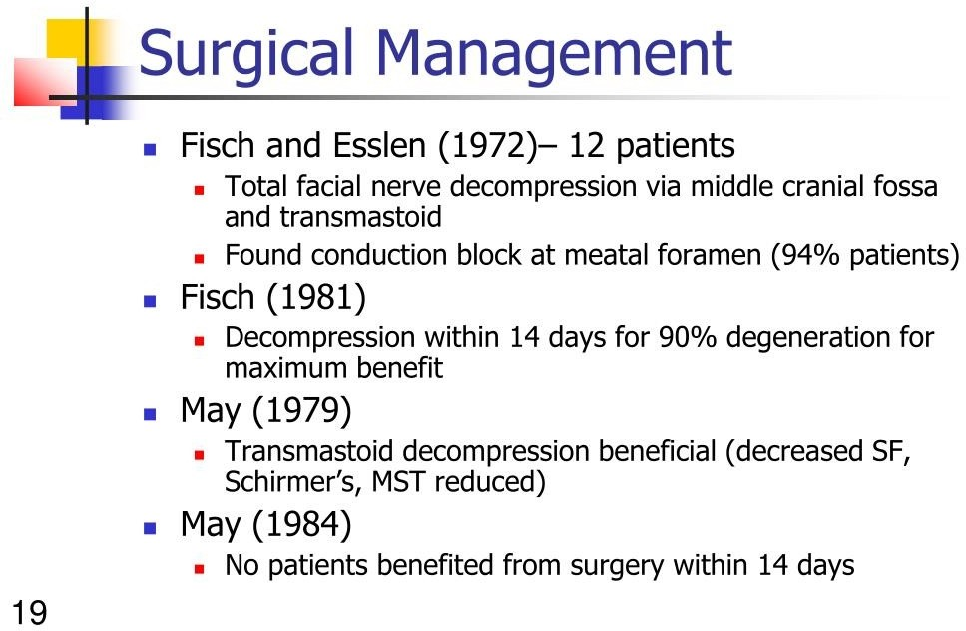

Slide 22
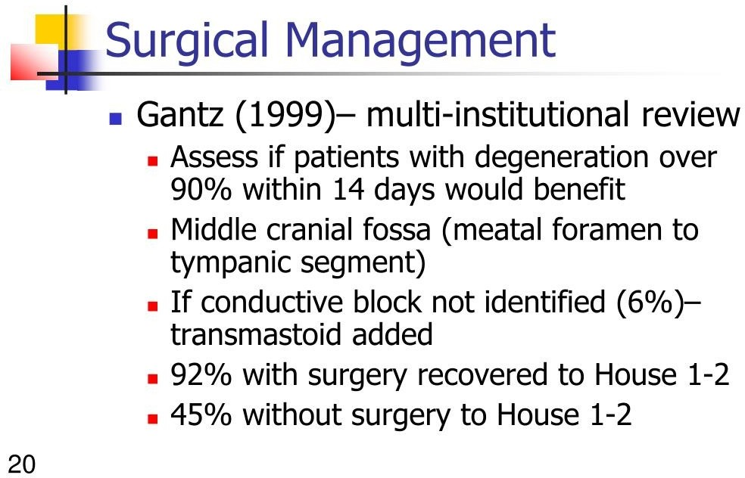

Slide 23
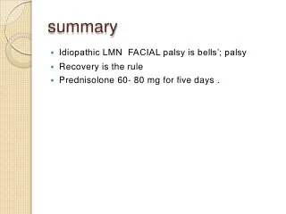
SUMMARY

Slide 24
REFERENCES
DAVIDSON’S PRINCIPLES AND PRACTICE OF MEDICINE; 23rd edition
HARRISON’S PRINCIPLE OF INTERNAL MEDICINE; 21ST edition
TEXTBOOK OF CLINICAL MEDICINE by S.N Chugh ;5th edition

Slide 25
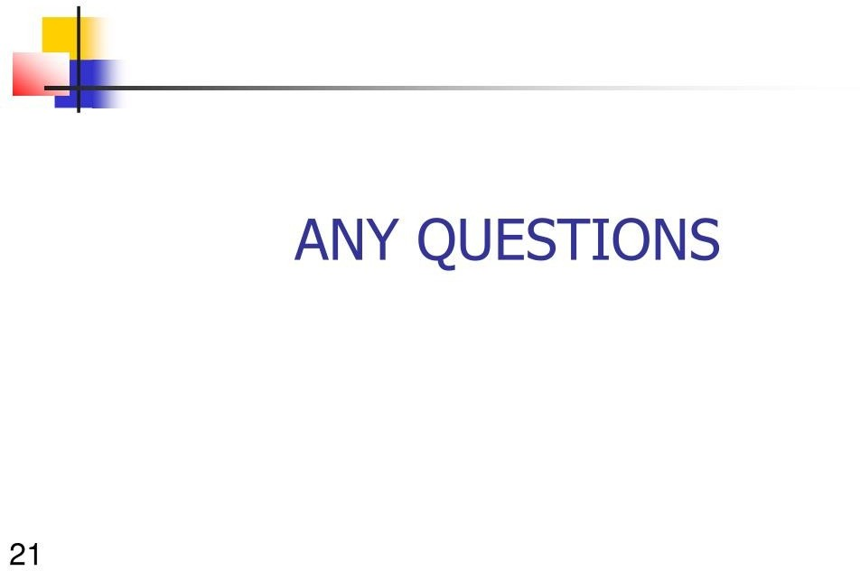

Slide 26
Thank you

